Slide 1
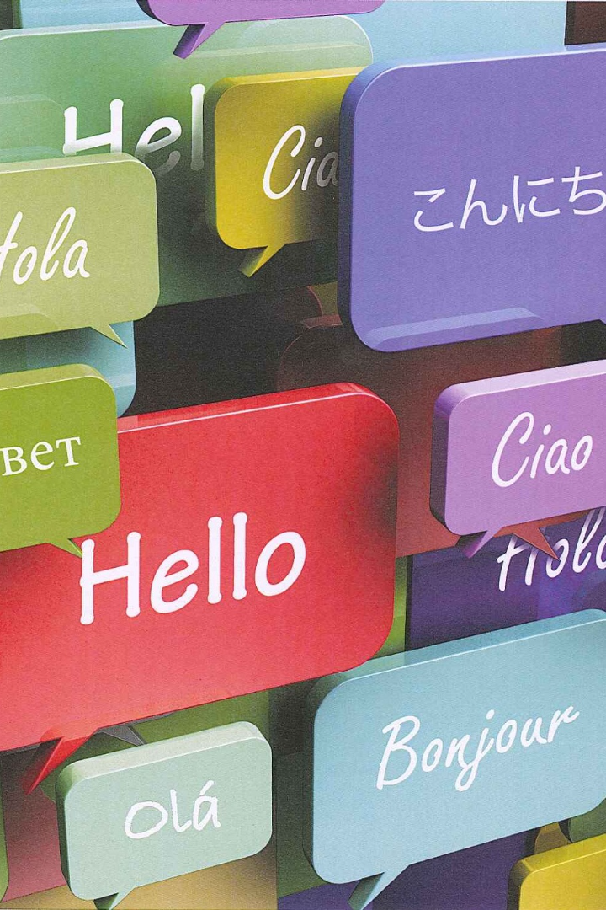

Pronoun Types
Explore the world of pronouns and their diverse types. Unveil the power of these linguistic gems and enhance your communication skills.
by Faseh Tariq

Slide 2

Definition of Pronouns
A pronoun is a word that can replace a noun or noun phrase and is used to avoid repetition in sentences. It is a key element in effective communication.

Slide 3
Personal Pronouns
Personal pronouns are used to refer to people, animals, or things. They are categorized into three groups: subject pronouns, object pronouns, and possessive pronouns.
Subject Pronouns
Object Pronouns
Possessive Pronouns
I, you, he/she/it, we, they
me, you, him/her/it, us, them
mine, yours, his/hers/its, ours, theirs

Slide 4

Reflective Pronouns
Reflective pronouns are used to reflect the action of the verb back to the subject. They end in -self (singular) or -selves (plural).
1
Singular
myself, yourself, himself/herself/itself
2
Plural
ourselves, yourselves, themselves

Slide 5
Relative Pronouns
Relative pronouns introduce relative clauses in a sentence. They include: who, whom, whose, which, and that.
Examples
The person who won the award was my sister. The dog that barks all night is annoying.

Slide 6
Demonstrative Pronouns
Demonstrative pronouns are used to point out specific people or things. They include: this, that, these, and those.
Examples
Put this on the shelf, not that. I prefer these over those.

Slide 7
Reciprocal Pronouns
Reciprocal pronouns indicate mutual action or relationship among multiple entities. They are "each other" and "one another".
1
Each Other
The twins always support each other in times of trouble.
One Another
2
The team members rely on one another to complete the project successfully.

Slide 8


Interrogative Pronouns
Interrogative pronouns are used to ask questions. They include: who, what, which, whom, and whose.
Who
What
Which
Who is your favorite author?
What is the capital city of France?
Which movie did you watch last night?
Whom
Whose
To whom did you send the email?
Whose car is parked in front of the house?

Slide 9
Examples and Usage
Pronoun Type
Example Sentence
Usage
Personal Pronouns
She loves playing the piano.
Referring to a specific person.
Possessive Pronouns
That book is mine.
Showing ownership.
Reflective Pronouns
I bought myself a gift.
Reflecting the action back to the subject.
Relative Pronouns
The movie that I watched was amazing.
Introducing a relative clause.
Demonstrative Pronouns
This is my new phone.
Pointing out specific people or things.
Reciprocal Pronouns
We love each other deeply.
Expressing mutual relationship or action.
Interrogative Pronouns
What is your favorite color?
Asking questions.

